Slide 1
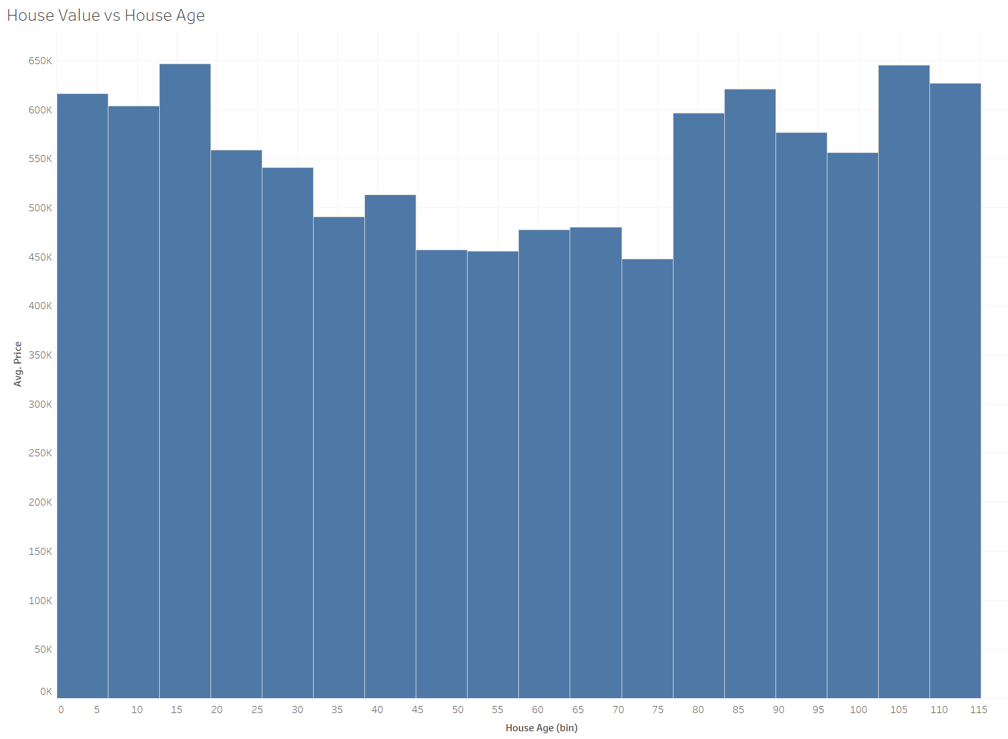
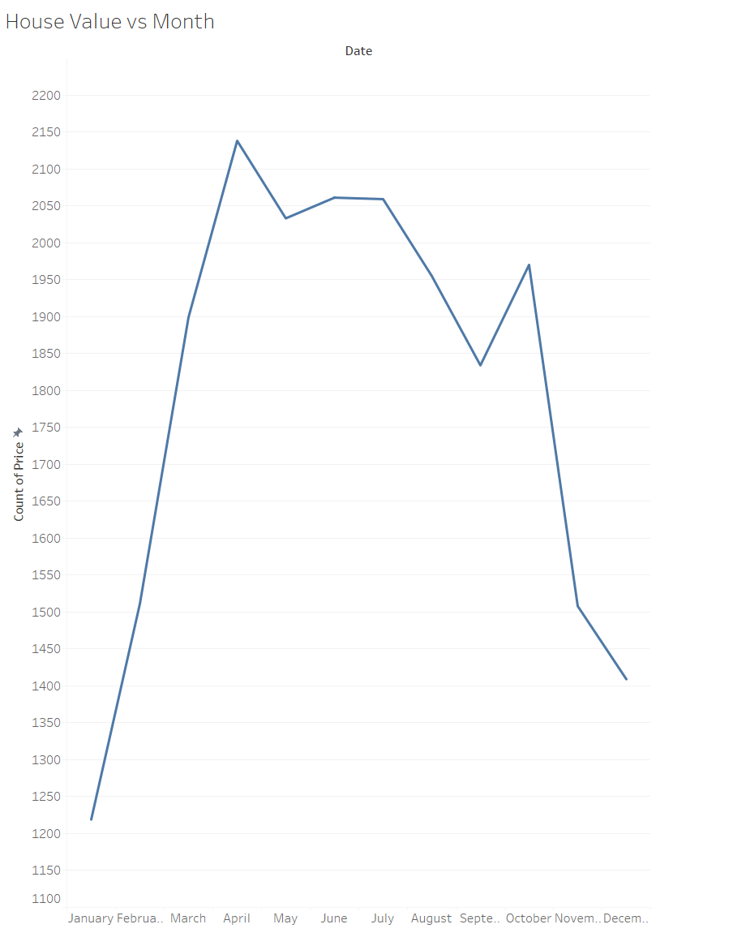
House age and sell date insights!
Peak in selling houses happens in the summer months.
Older and newer houses with higher average price!

Slide 2
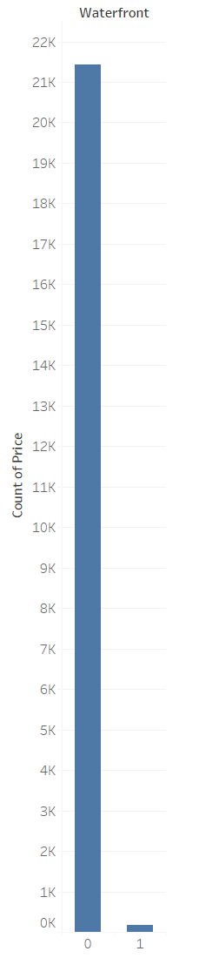
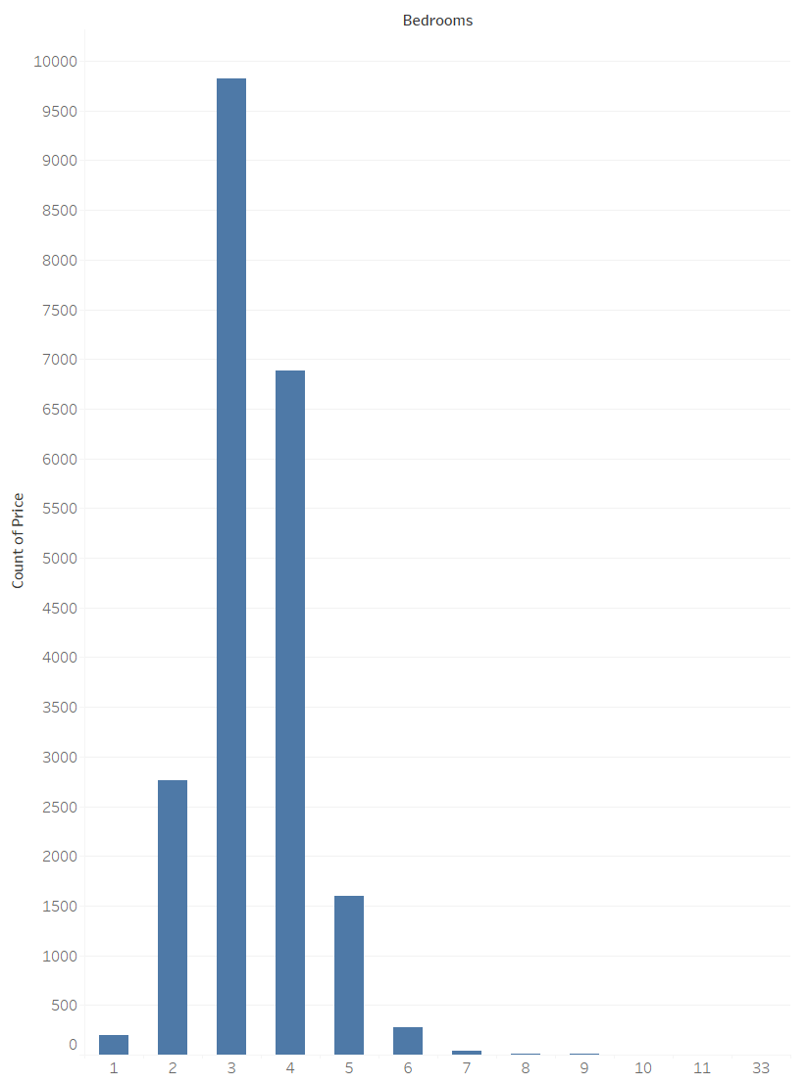
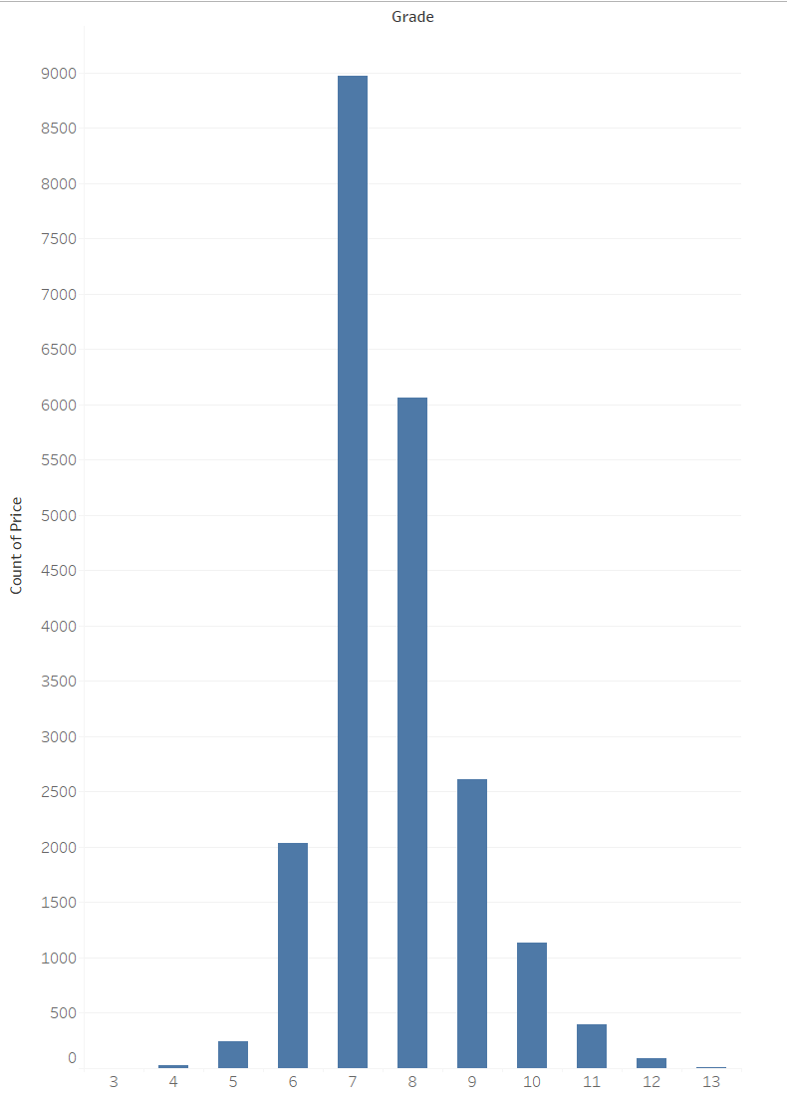
The most interesting are 3-bedroom or 4-bedroom houses with an average grade and no waterfront.
Houses with 3 or 4 bedroom most popular!
Sold houses have an average grade!

Slide 3
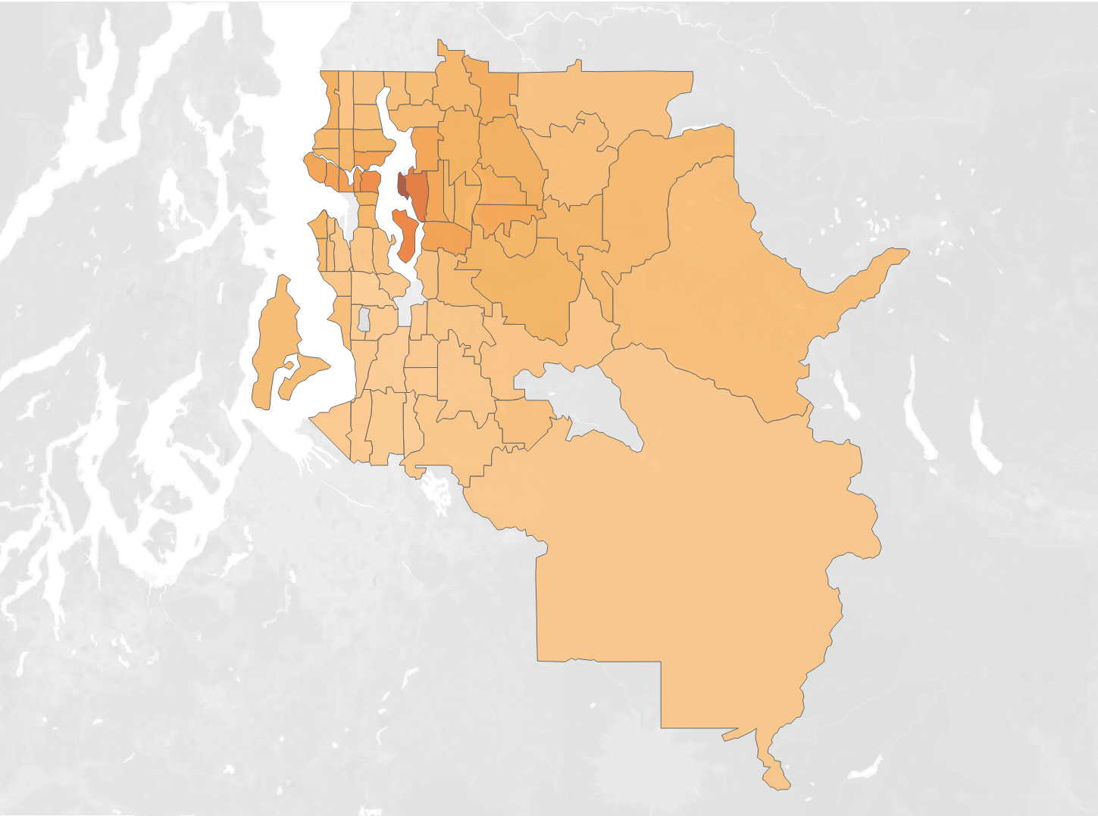
Location and size of the house highly correlated to a price!

Slide 4
